Slide 1
MOBILE LEARNING IN HIGHER EDUCATION:
THE CASE OF UNIVERSIDADE ABERTA (PORTUGAL)
Teresa Cardoso [tcardoso@uab.pt]
Glória Bastos ]

Slide 2
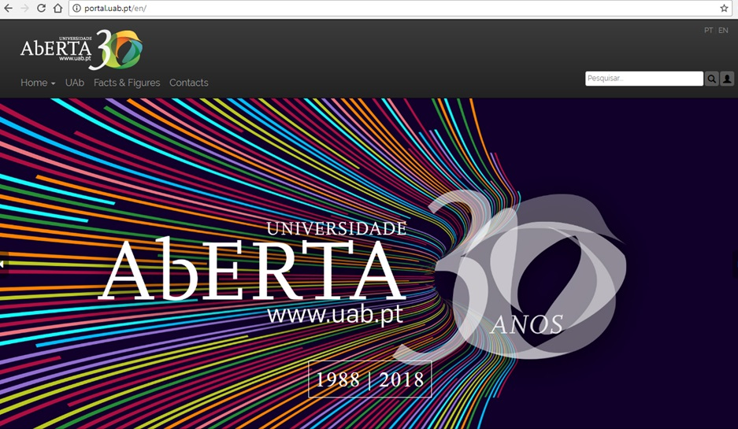
Agenda
Introduction
Methodology
Results
Conclusions
Acknowledgements

Slide 3
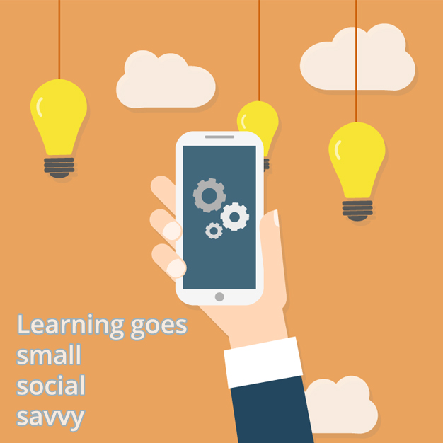
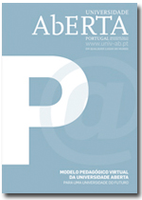
Introduction
student-centered learning
digital inclusion
interaction
flexibility
learning goes mobile
learning anywhere, anytime
https://goo.gl/eAsBHF
http://hdl.handle.net/10400.2/2388

Slide 4
Methodology
a 52-question survey with 6 sections, based on a Likert and a semantic differential scales
- How students of the UAb use digital tools and devices for their learning?
- How they evaluate those tools with regard to the learning context?

Slide 5
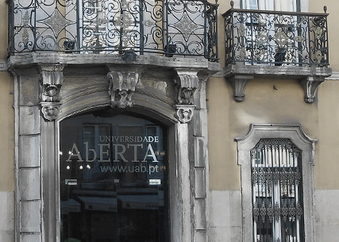
Results
Social and demographic characterization
female
over 40 yrs old
Portuguese
living in Lisbon
students in a post-graduation course

Slide 6
Results
Contexts of digital tool and device usage for studying and learning > teacher-student interaction
* the use of digital tools is still very much associated to formal education and formal learning scenarios
students see the teacher as the key in (formal) learning

Slide 7
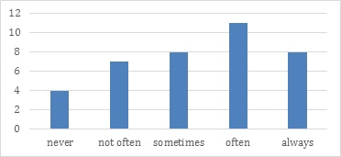
Results
Contexts of digital tool and device usage for studying and learning > teacher-student interaction
> use of the e-mail by the students to contact with the teacher <
https://goo.gl/62th23

Slide 8
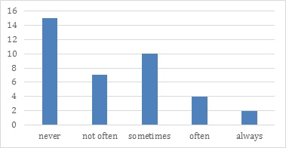
Results
Contexts of digital tool and device usage for studying and learning > teacher-student interaction
https://goo.gl/n5Nn2k
> use of synchronous conferencing tools by the students to contact with the teacher <
https://goo.gl/z6StPv

Slide 9
Results
Contexts of digital tool and device usage for studying and learning > teacher-student interaction
* students don't use social media to contact with the teacher;
* they use the LMS forums, followed by the e-mail
students see the teacher as the key in (formal) learning

Slide 10
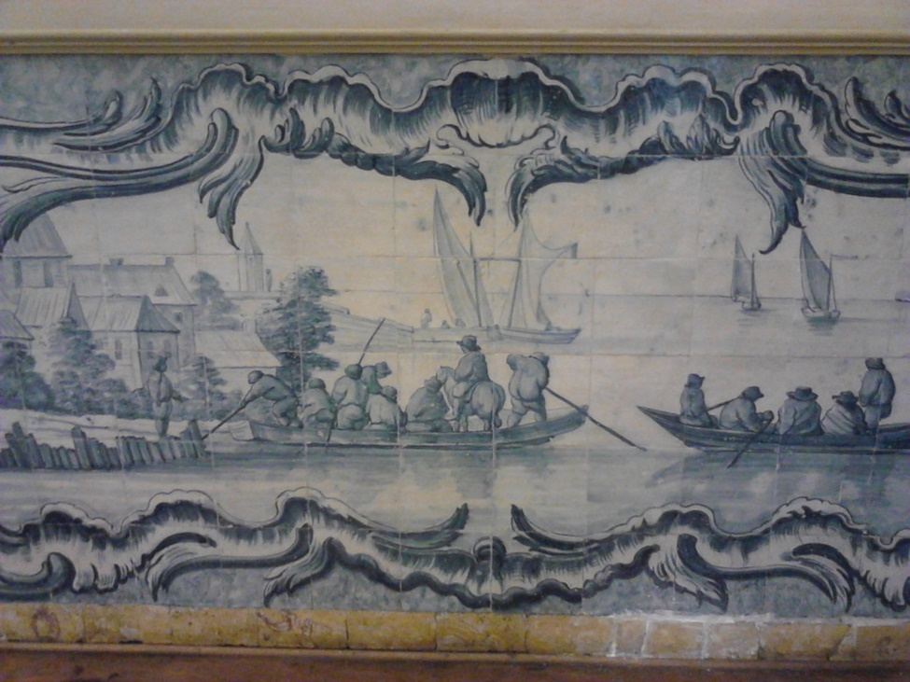
Conclusions
Students use the digital tools (namely forums at UAb Moodle and the e-mail) for educational purposes based primarily on the teacher's recommendation.

Slide 11
Acknowledgements
The research described on this talk was developed under a project funded by Erasmus+ programme, “MINE – Mobile Learning in Higher Education, 2016-1-AT01-KA203-016784”.

Slide 12
MOBILE LEARNING IN HIGHER EDUCATION:
THE CASE OF UNIVERSIDADE ABERTA (PORTUGAL)
Gratas pela atenção!
Teresa Cardoso [tcardoso@uab.pt]
Glória Bastos ]

